Slide 1

Day School 1 EEX 3467 – Software Engineering Concepts and Programming
Centre for IT Educational Services (CITES)
The Open University of Sri Lanka 30/01/2022

Slide 2

Acknowledgement
This presentation was prepared by adopting the slides originally prepared by
Prof. Uditha Ratnayake
Dr. A. P. Madurapperuma
Mr. Neil Hereath

Slide 3
Syllabus
Unit 1
Session 1: Software System for Engineers
Session 2: Evolution of Program Paradigms
Session 3: Introduction to Software Engineering
Session 4: Requirement Elicitation and Documents
Session 5:Requirement Analysis with Data Flow Diagram and Unified Modeling Language
Session 6: Structured Programming
Session 7: Function Oriented Design
Unit 2
Session 8: Algorithms
Session 9: Programming with C language
Session 10: Data Types and Variables in C
Session 11: C Operators and Expressions
Session 12: Control Structures in C
Session 13: Basic input output
Session 14: Functions in C
Session 15: Data Structures
Session 16: Dynamic data structures
Unit 3
Session 15: Introduction to Software Engineering
Session 16: Overview of Process Model
Session 17: Agile Model
Unit 4
Session 18: Requirement Elicitation
Session 19: Requirement Analysis
Session 20: Object Oriented Principle
Session 21: Software Testing
Session 22: Software Quality Metrics
Session 23: Software Deployment
Session 24: Software Maintenance
Session 25: Software Security
Session 26: Introduction to Software Project Management
Session 27 Project Planning and Cost Estimation
Center for IT Education Services (CITES)

Slide 4
Goals of this Day school
Discuss the importance of Software Systems for Engineers
Evolution of program paradigm
Introduction to Software Engineering
Introduction to Algorithms
Introduction to C programming
Center for IT Education Services (CITES)

Slide 5
The importance of Software Systems for Engineers
Software has become an invisible thread tying all fields of studies together
As an engineer, you may need to know the process of software development for creating your own simple programs as well as for using application software for analyzing, designing and modeling of work in any other fields
Computer systems controlled by software systems are playing a major role in many fields such as :
agriculture
civil
electrical
Communication
mechanical
Textile etc…
Center for IT Education Services (CITES)

Slide 6
What is a Software System?
A software system is a set of interrelated computer programs and configuration software and files which are arranged in an organized way to achieve a specific goal with system documentation, test results and user documentation.
Center for IT Education Services (CITES)

Slide 7
Software System…
Computer program - A set of instructions that tells computer hardware what to do.
Software - A set of programs to perform a specific task.
Documentation –
An important part of any software system.
It is hard to see a software system as a tangible product.
It is system documentation and user documentation that someone can see as the software product being purchased.
Center for IT Education Services (CITES)

Slide 8
Software Classifications
System software
A special type of a computer program.
Works either between application programs and hardware or between user and hardware.
There are 5 main categories –
Operating system
Device drivers
Firmware
Programming language translators
Utility software
Center for IT Education Services (CITES)

Slide 9
Application Software
Application software are also called end user programs.
They run over the OS.
Application software market can be categorized into two types, horizontal and vertical market application software.
Center for IT Education Services (CITES)

Slide 10





Software used in Engineering
Horizontal Application Software
Vertical Application Software
Word processing software
Accounting software
Database management systems
Project management software
Numerical computation software such as MATLAB
Design software such as OrCAD, AUTOCAD
Center for IT Education Services (CITES)

Slide 11
What is a Computer Program?
A computer program is a collection of instructions that describe a task or set of tasks to be carried out by a computer.
Almost every program performs 3 basic tasks.
Manipulate data
Perform operations
Provide results
Center for IT Education Services (CITES)

Slide 12
We give instructions to computers by means of programs.
Programs translate instructions from a human readable format to a computer readable format.
In order to develop programs, programming languages are being used.
Center for IT Education Services (CITES

Slide 13
History of Programming Languages
Earlier the computer programs were written in the actual language of the computer.
Nowadays the programmer writes his/her program in a programming language which is relatively easy to learn and error free.
These languages can be considered as;
Machine language
Assembly language
High-level language
Center for IT Education Services (CITES

Slide 14
Machine language
The lowest level of language which represents information as 1s and 0s - binary digits corresponding to the “on” and “off” electrical states in the computer.
Refer pg No 20 of block 01
Center for IT Education Services (CITES

Slide 15
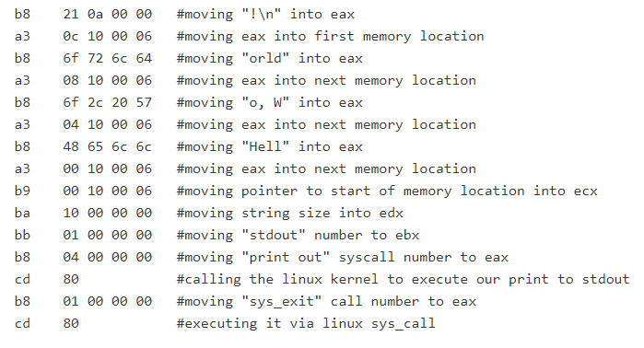
Example - Hello World:
Machine code is not really readable by humans and humans can only do trivial things with it but all software is eventually turned into Machine code before it’s sent to the CPU.
Center for IT Education Services (CITES

Slide 16
Assembly language
Rather than using simply 1s and 0s, assembly language uses abbreviations or mnemonic codes to replace the numbers: A for “Add”, CMP for “Compare”, MUL for “Multiply”, and so on.
The programmer who uses an assembly language requires a translator to convert his or her assembly language program into machine language.
Center for IT Education Services (CITES)

Slide 17
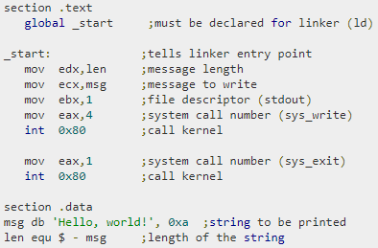
Example - Hello World:
Center for IT Education Services (CITES)

Slide 18
High-Level Languages
High level languages move away from machine dependence and are generally more problem oriented.
A few distinct features of high-level languages;
Have an extensive vocabulary of words, symbols and sentences.
As they are problem oriented the programmer is able to work independently of the machine.
A set of rules must be obeyed when writing the source program, similar to rules of grammar in writing English.
Center for IT Education Services (CITES)

Slide 19
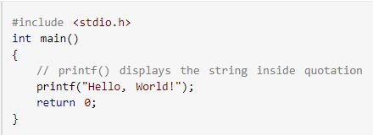
Example - Hello World:
Center for IT Education Services (CITES)

Slide 20
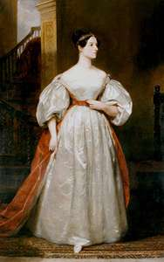
Programming paradigms
First Computer Program was created by:
ADA LOVELACE
Work on the Charles Babbage’s analytical engine.
Developed a method for calculating Bernoulli numbers with the Engine.
Augusta Ada Byron
World’s First Computer Programmer
Center for IT Education Services (CITES

Slide 21
Declarative programming
paradigm
Imperative programming
paradigm
Describes "what" a program should accomplish
Logic, functional and
Domain-specific
languages belong under declarative paradigms
Ex: HTML, XML, CSS, SQL, Prolog
Explicitly tells the computer "how" to accomplish it.
Procedural and
object-oriented programming belong under imperative paradigm
Ex: C, C++, C#, PHP, Java
Center for IT Education Services (CITES

Slide 22
Introduction to Software Engineering
What is Software Engineering?
IEEE, in its standard 610.12-1990, defines software engineering as:
The application of a systematic, disciplined, quantifiable approach to the development, operation and maintenance of software; that is, the application of engineering to software.
the study of approaches as in (1).
Center for IT Education Services (CITES

Slide 23
The Software Life-Cycle
Includes the following stages:
Concept and feasibility: Identify a marketing opportunity, or an organizational need.
Requirements capture: Agree on what functions the system is to perform, in consultation with the customer.
Center for IT Education Services (CITES

Slide 24
Requirements specification: Write a detailed document including functional requirements (What will the system do?) and non-functional requirements (What level of quality must it have? What constraints are there on its design and implementation?).
High-level design: How will the system meet its requirements?
Center for IT Education Services (CITES)

Slide 25
Implementation: Individual modules are written in source code, complied and integrated to build the complete system. User documentation is written.
Testing: First individual modules and then progressively larger subsystems are tested to verify that they meet their own specifications.
Trial: The complete system is operated in a realistic environment to validate that it meets its original requirements.
Center for IT Education Services (CITES)

Slide 26
Deployment: Release to customers and installation on site.
Operation and Maintenance: The system may need to have faults corrected, be adapted to new circumstances, or be enhanced to perform new functions.
Obsolescence: Retire and replace.
Center for IT Education Services (CITES)

Slide 27
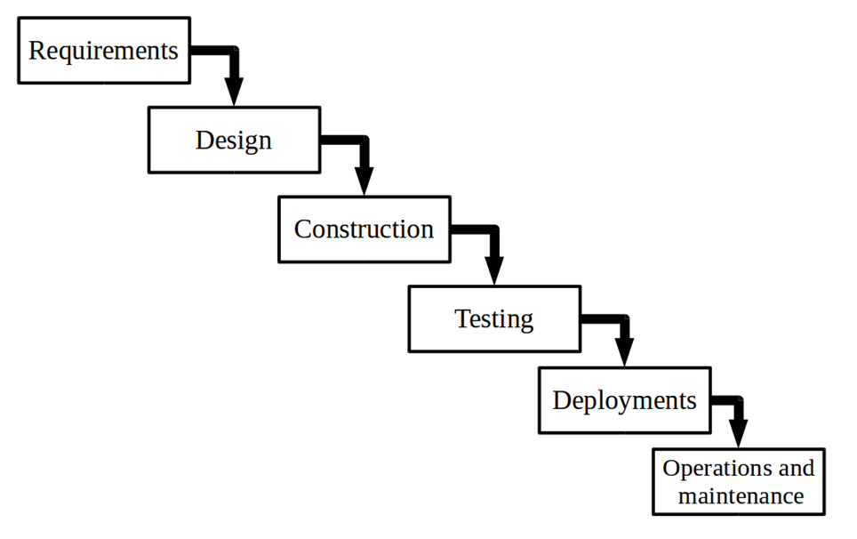
Waterfall Life Cycle Model
Center for IT Education Services (CITES)

Slide 28
Let us assume that the City Bank is planning to develop a new banking application.
Center for IT Education Services (CITES

Slide 29
Requirements Gathering and Analysis
In this phase the requirements are gathered by the business analyst and they are analyzed by the team.
Requirements are documented and clarifications can be sought.
Will the new banking application be used in more than one country?
Do we have to support multiple languages?
How many users are expected to use the application? etc.
Center for IT Education Services (CITES

Slide 30
System Design
The architect and senior members of the team work on the software architecture, high level and low level design for the project.
It is decided that the banking application needs to have redundant backup and failover capabilities such that system is accessible at all times.
The architect creates the Architecture diagrams and high level / low level design documents.
Center for IT Education Services (CITES

Slide 31
Construction
The development team works on coding the project.
They take the design documents / artifacts and ensure that their solution follows the design finalized by the architect.
Since the application is a banking application and security was a high priority in the application requirements, they implement several security checks, audit logging features in the application.
Center for IT Education Services (CITES

Slide 32
Testing
The testing team tests the complete application and identifies any defects in the application.
These defects are fixed by the developers and the testing team tests the fixes to ensure that the defect is fixed.
The project will also be tested by Testers with banking domain knowledge so that they could test the application based on the domain perspective.
Security of the banking application will also be tested by Security testing teams.
Center for IT Education Services (CITES)

Slide 33
Deployment
The team builds and installs the application on the servers which were procured for the banking application.
Some of the activities include installing the OS on the servers, installing security patches, installing web servers and application servers, installing the database etc.
They also co-ordinate with network and IT administrative teams etc…to finally get the application up and running on the production servers.
Center for IT Education Services (CITES)

Slide 34
Maintenance
During the maintenance phase, the team ensures that the application is running smoothly on the servers without any downtime.
Center for IT Education Services (CITES)

Slide 35
Algorithms
What is an Algorithm?
An algorithm is a set of step by step instructions for solving a problem to achieve a result.
Algorithms are especially important to computers because computers are general purpose machines for solving problems.
Center for IT Education Services (CITES)

Slide 36
There are five important characteristics of an algorithm as stated below.
An algorithm is well-ordered.
An algorithm has unambiguous operations.
An algorithm has effectively computable operations.
An algorithm produces a result.
An algorithm halts in a finite amount of time.
Center for IT Education Services (CITES

Slide 37
Why need algorithm for computer programming?
Computer is a general purpose machine, that can perform any computational task. To do a task by computer you have to give a set of instructions step by step.
A set of instructions to understand the computer is a computer program. There are variety of computer program like C, java, python etc...
Writing a set of instructions common for all the computer program is called an algorithm.
Center for IT Education Services (CITES

Slide 38

Let’s have a cup of tea…
What are the steps involved in making a cup of tea?
Center for IT Education Services (CITES

Slide 39
Algorithm Examples
Making a cup of tea
Step 01 - Fill the kettle with water.
Step 02 - Boil the water in the kettle.
Step 03 - Put the teabag in a cup
Step 04 - Pour some of the boiled water into the cup.
Step 05 - Add milk to the cup.
Step 06 - Add sugar to the cup.
Step 07 - Stir the tea.
Step 08 - Drink the tea.
Center for IT Education Services (CITES

Slide 40
Algorithm Examples
What if milk is not needed?
What if more sugar is needed?
What if no sugar?
Center for IT Education Services (CITES

Slide 41
Algorithm Examples
To find sum of 2 numbers
Step 1: start
Step 2: read first number (A)
Step 3: read second number (B)
Step 4: C=A+B
Step 5: print or display C
Step 6: stop
Center for IT Education Services (CITES)

Slide 42
Representation of Algorithms
An algorithm can be formally represented either graphically as a flowchart or with a textual method like pseudo code.
Pseudo code is more concise and clear than structured English.
Representing your problem solution with a flow chart or pseudo code, allows you to concentrate on the logic of the solution without worrying about the programming language syntax.
Refer pg No 100 of block 01
Center for IT Education Services (CITES)

Slide 43
Representation of Algorithms
Example:-write an algorithm for adding all even numbers between 2 and 1000 to the Sum- Even-numbers
Structured English
Pseudo Code
Initialize Sum-of-Even-numbers
Intialize an index
Repeat Until index is 1000
Increment the index by 2
Add index to Sum-of-Even-numbers
Sum-of-Even-numbers = 0
Number = 0
Repeat Number = Number +2
Sum-of-Even-numbers = Sum-of-Even-numbers + Number
Until Number == 1000
Refer pg No 102 of block 01
Center for IT Education Services (CITES)

Slide 44
Flow Chart
Flow Chart is a diagram representing the process flow of computer programs using shapes and arrows.
Center for IT Education Services (CITES)

Slide 45






Symbols Used In Flowchart
Symbol | Purpose | Description
 | Flow line | Used to indicate the flow of logic by connecting symbols.
 | Terminal(Stop/Start) | Used to represent start and end of flowchart.
 | Input/ Output | Used for input and output operations.
 | Processing | Used for arithmetic operations and data-manipulations.
 | Decision | Used to represent the operation in which there are two alternatives, true and false.
 | On-page Connector | Used to join different flow lines
 | Predefined Process/Function | Used to represent a group of statements performing one processing task.
Center for IT Education Services (CITES)

Slide 46
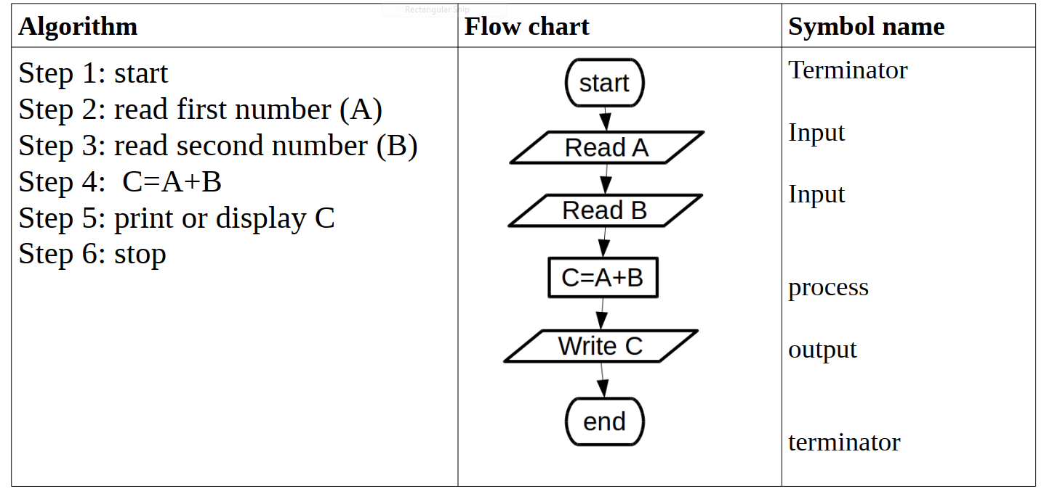
Algorithm and Flow chart Examples
To find sum of 2 numbers
Center for IT Education Services (CITES)

Slide 47

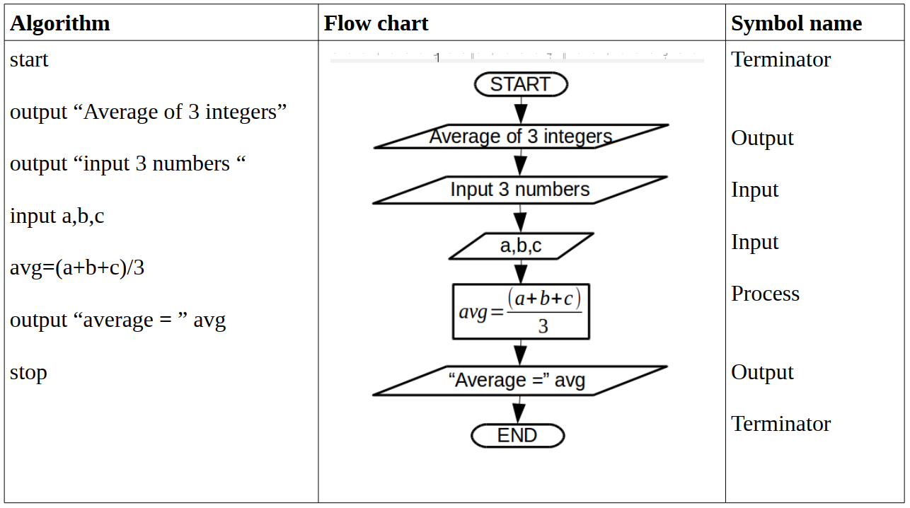
Find the average of 3 integers called a,b,c Example →
Sequence
Center for IT Education Services (CITES

Slide 48
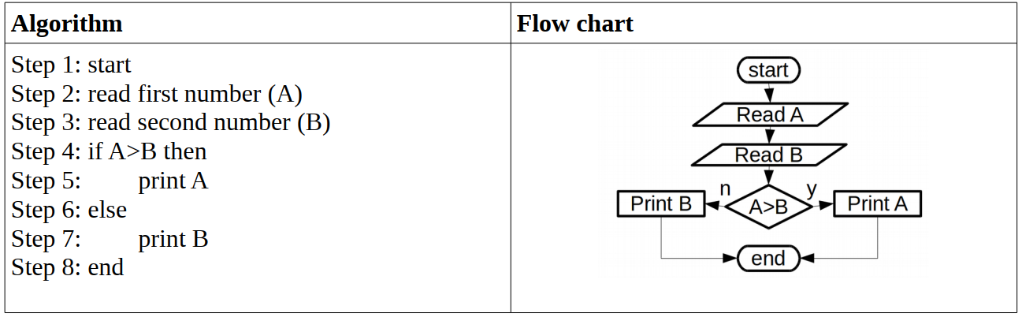
Selection
Greatest of 2 numbers
Is this correct?
Center for IT Education Services (CITES

Slide 49
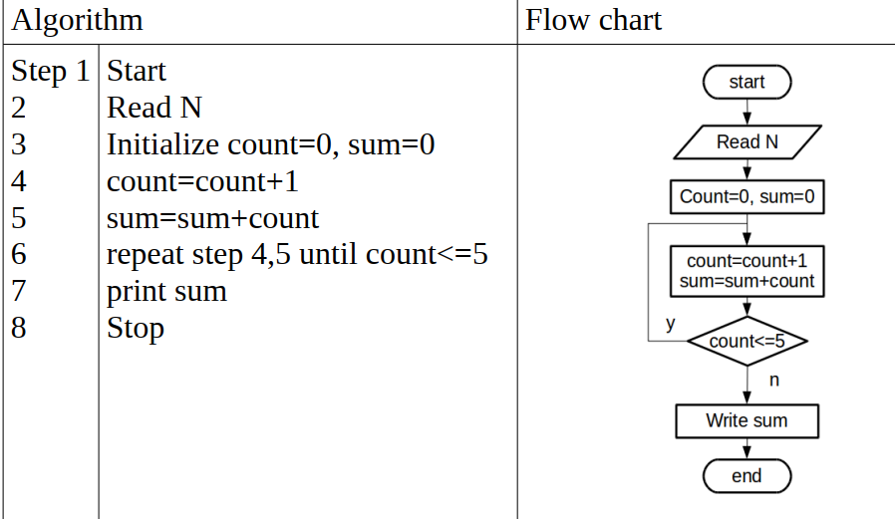
Algorithm and flow chart to find the sum of first five natural numbers (sum of 1,2,3,4,5) Example: 1+2+3+4+5=15
Repetition
Center for IT Education Services (CITES

Slide 50
D.S. Activity 1.2
Now write an Algorithm and a flow chart to find the volume of a cylinder.
When “r” is the radius of the cylinder, “h” is the height of the cylinder and V is the Volume of the cylinder and the Volume of a cylinder is V=πr²h
Center for IT Education Services (CITES

Slide 51
D.S. Activity 1.3
Now write an Algorithm and a flow chart to display numbers from 20 to 100 using a repetition structure.

Slide 52
Introduction to C programming
C is considered as a high-level programming language.
Statements in C are English-like and closer to human language, which is easy to read and write.
Since the computer can understand only the machine language, a program that is written using C needs to be translated into the machine language before executing.
Center for IT Education Services (CITES)

Slide 53
C is considered as a high-level programming language.
Statements in C are English-like and closer to human language, which is easy to read and write.
Since the computer can understand only the machine language, a program that is written using C needs to be translated into the machine language before executing.
Center for IT Education Services (CITES)

Slide 54
C is considered as a high-level programming language.
Statements in C are English-like and closer to human language, which is easy to read and write.
Since the computer can understand only the machine language, a program that is written using C needs to be translated into the machine language before executing.
Center for IT Education Services (CITES)

Slide 55
Hello World Example
A C program basically consists of the following parts −
Preprocessor Commands
Functions
Variables
Statements & Expressions
Comments
Center for IT Education Services (CITES)

Slide 56
A preprocessor command, which tells a C compiler to include stdio.h file before going to actual compilation.
#include <stdio.h>
int main() {
/* my first program in C */
printf("Hello, World! \n");
return 0;
}
Center for IT Education Services (CITES

Slide 57
The main function where the program execution begins.
#include <stdio.h>
int main() {
/* my first program in C */
printf("Hello, World! \n");
return 0;
}
Center for IT Education Services (CITES

Slide 58
Will be ignored by the compiler and it has been put to add additional comments in the program. So such lines are called comments in the program.
#include <stdio.h>
int main() {
/* my first program in C */
printf("Hello, World! \n");
return 0;
}
Center for IT Education Services (CITES

Slide 59
A function available in C which causes the message "Hello, World!" to be displayed on the screen.
#include <stdio.h>
int main() {
/* my first program in C */
printf("Hello, World! \n");
return 0;
}

Slide 60
Terminates the main() function and returns the value 0
#include <stdio.h>
int main() {
/* my first program in C */
printf("Hello, World! \n");
return 0;
}
Center for IT Education Services (CITES)

Slide 61
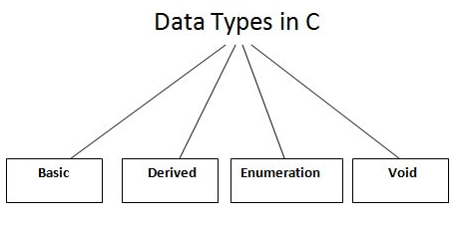
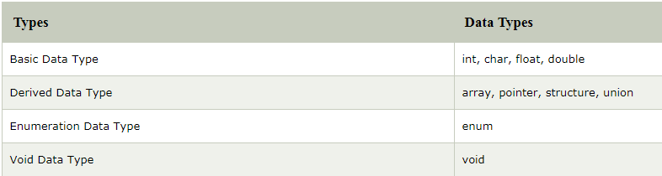
C - Data Types
Center for IT Education Services (CITES)

Slide 62
Variables in C Language
A variable is nothing but a name given to a storage area that our programs can manipulate.
Unlike constant, variables are changeable, we can change value of a variable during execution of a program.
Center for IT Education Services (CITES)

Slide 63
Data types of Variable
A variable in C language must be given a type, which defines what type of data the variable will hold.
It can be:
char: Can hold/store a character in it.
int: Used to hold an integer.
float: Used to hold a float value.
double: Used to hold a double value.
void
Center for IT Education Services (CITES)

Slide 64
Rules to name a Variable
Variable name must not start with a digit.
Variable name can consist of alphabets, digits and special symbols like underscore _.
Blank or spaces are not allowed in variable name.
Keywords are not allowed as variable name.
Upper and lower case names are treated as different, as C is case-sensitive, so it is suggested to keep the variable names in lower case.
Center for IT Education Services (CITES

Slide 65

Thank you
PO Box 21, Nawala, Nugegoda, Sri Lanka
Phone: +94 11 288 100
www.ou.ac.lk

